Slide 1
Cloud Computing Standardization and Reference Architecture
Standardization of cloud computing
Cloud Computing Reference Architecture
Cloud computing standards and laws in China
Cloud computing adoption issues

Slide 2
Technology adoption
Technology adoption refers to the process of accepting, integrating, and using new technology

Slide 3
Cloud computing adoption
Cloud Computing has been adopted by many economic sectors due to the multiple services offered by CSPs
Therefore, Cloud has become an important part of our life today; indeed, one is heavily dependent on it indirectly or directly

Slide 4
Cloud adoption perspectives
Adoption
By society
By industries and businesses
By countries
…

Slide 5
Cloud adoption perspectives
Adoption
By society
We will talk about the research and theories in technology adoption area
By industries and businesses
We will look at practical issues faced by organizations
By countries
We will look at the results of recent surveys

Slide 6
Cloud adoption perspectives
Adoption
By society
We will talk about the research and theories in technology adoption area
By industries and businesses
We will look at practical issues faced by organizations
By countries
We will look at the results of recent surveys

Slide 7

Cloud adoption by society
technology adoption refers to the process of accepting, integrating, and using new technology in society

Slide 8
Research on technology adoption

Slide 9

Diffusion vs adoption
Diffusion is the process by which a new idea or new product is accepted by the market
The rate of diffusion is the speed with which the new idea spreads from one consumer to the next
Adoption (the reciprocal process as viewed from a consumer perspective rather than distributor) is similar to diffusion except that it deals with the psychological processes an individual goes through, rather than an aggregate market process

Slide 10
Rate of diffusion factors
The rate of diffusion is influenced by:
The product's perceived advantage or benefit
Riskiness of purchase
Ease of product use – complexity of the product
Immediacy of benefits
Observability
Trialability
Price
Extent of behavioral changes required
Return on investment in the case of industrial products
…

Slide 11
Diffusion theories
There are several theories that purport to explain the mechanics of diffusion:
The two-step hypothesis
The trickle-down effect
The diffusion of innovations
Technology driven models
…

Slide 12
The two-step hypothesis
Information and acceptance flows, via the media, first to opinion leaders, then to the general population

Slide 13
The trickle-down effect
Products tend to be expensive at first, and therefore only accessible to the wealthy social levels – in time they become less expensive and are diffused to lower and lower levels

Slide 14

Diffusion of innovations
Diffusion of innovations is a theory that seeks to explain how, why, and at what rate new ideas and technology spread
Diffusion is the process by which an innovation is communicated over time among the participants in a social system

Slide 15
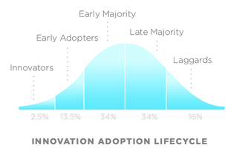
Technology adoption life cycle
a sociological model that describes the adoption or acceptance of a new product or innovation
follows the profile of a bell curve
the area under the curve represents the total number of customers for the new technology
describes 5 categories of adopters, according to the demographic and psychological characteristics of defined adopter groups

Slide 16
Adopter categories
For any new idea, concept, product or method, there are five categories of adopters:
Innovators
Early adopters
Early majority
Late majority
Laggards

Slide 17
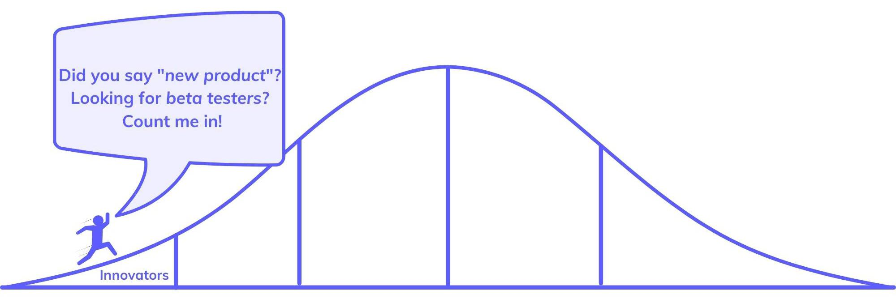
Innovators
The very first adopters of a technology
The smallest group

Slide 18
Innovators factors
Youngest among all groups
Have the highest social status
Have closest contact to scientific sources and interaction with other innovators
gives them the edge in knowledge and understanding of new technologies
Willing to take risks
Their risk tolerance allows them to adopt technologies that may ultimately fail - they are likely to purchase an item despite knowing it may not become successful
Have financial liquidity
Financial resources help absorb these failures

Slide 19
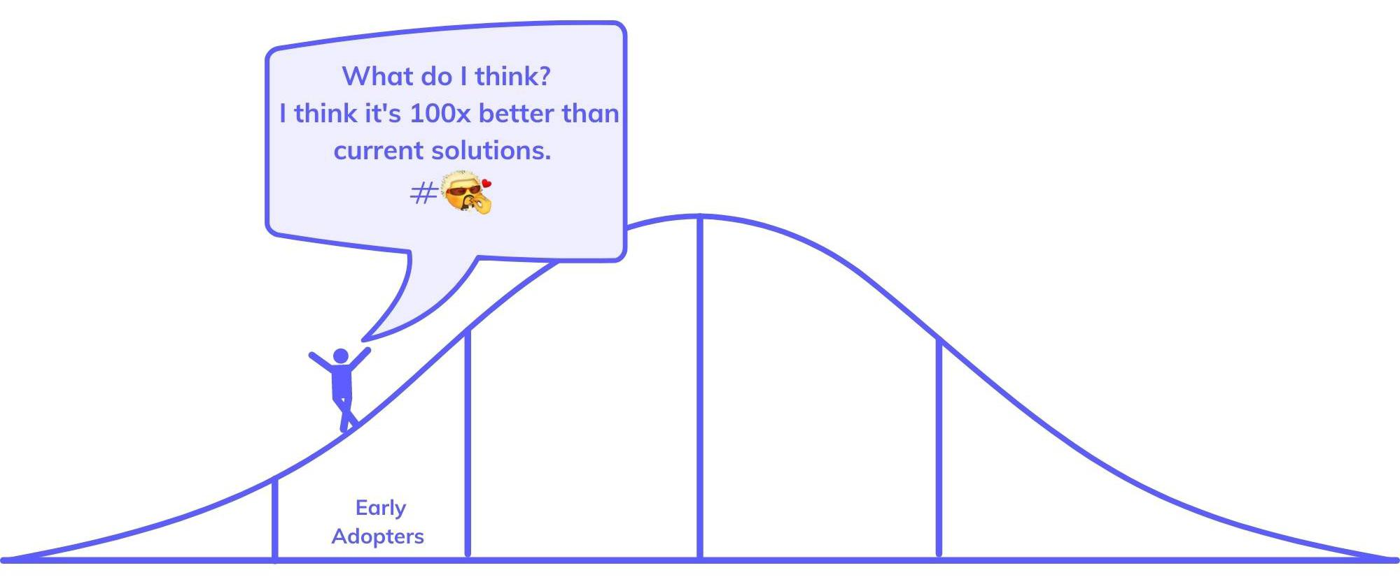
Early adopters
the second to adopt new technologies

Slide 20
Early adopters factors
Slightly older than innovators but more youthful than remaining groups
The most sociable of all the groups and communicate their opinions and ideas more effectively, frequently, and to larger audiences
Opinion leaders
they inform the opinions of others around them the most out of all five groups
High social status
Usually have a higher education level than all the groups
As a result of this education, early adopters are more careful and take time to research the best products for them
They are more discreet in adoption choices than innovators

Slide 21
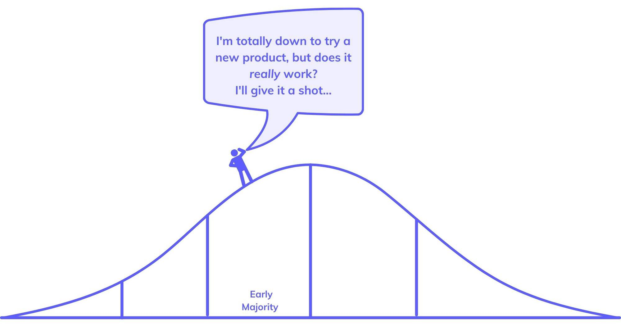
Early Majority
The time for adoption is significantly longer

Slide 22
Early Majority factors
They adopt an innovation after a varying degree of time that is significantly longer than the innovators and early adopters
Above average social status
Have contact with early adopters
Seldom hold positions of opinion leadership in a system

Slide 23
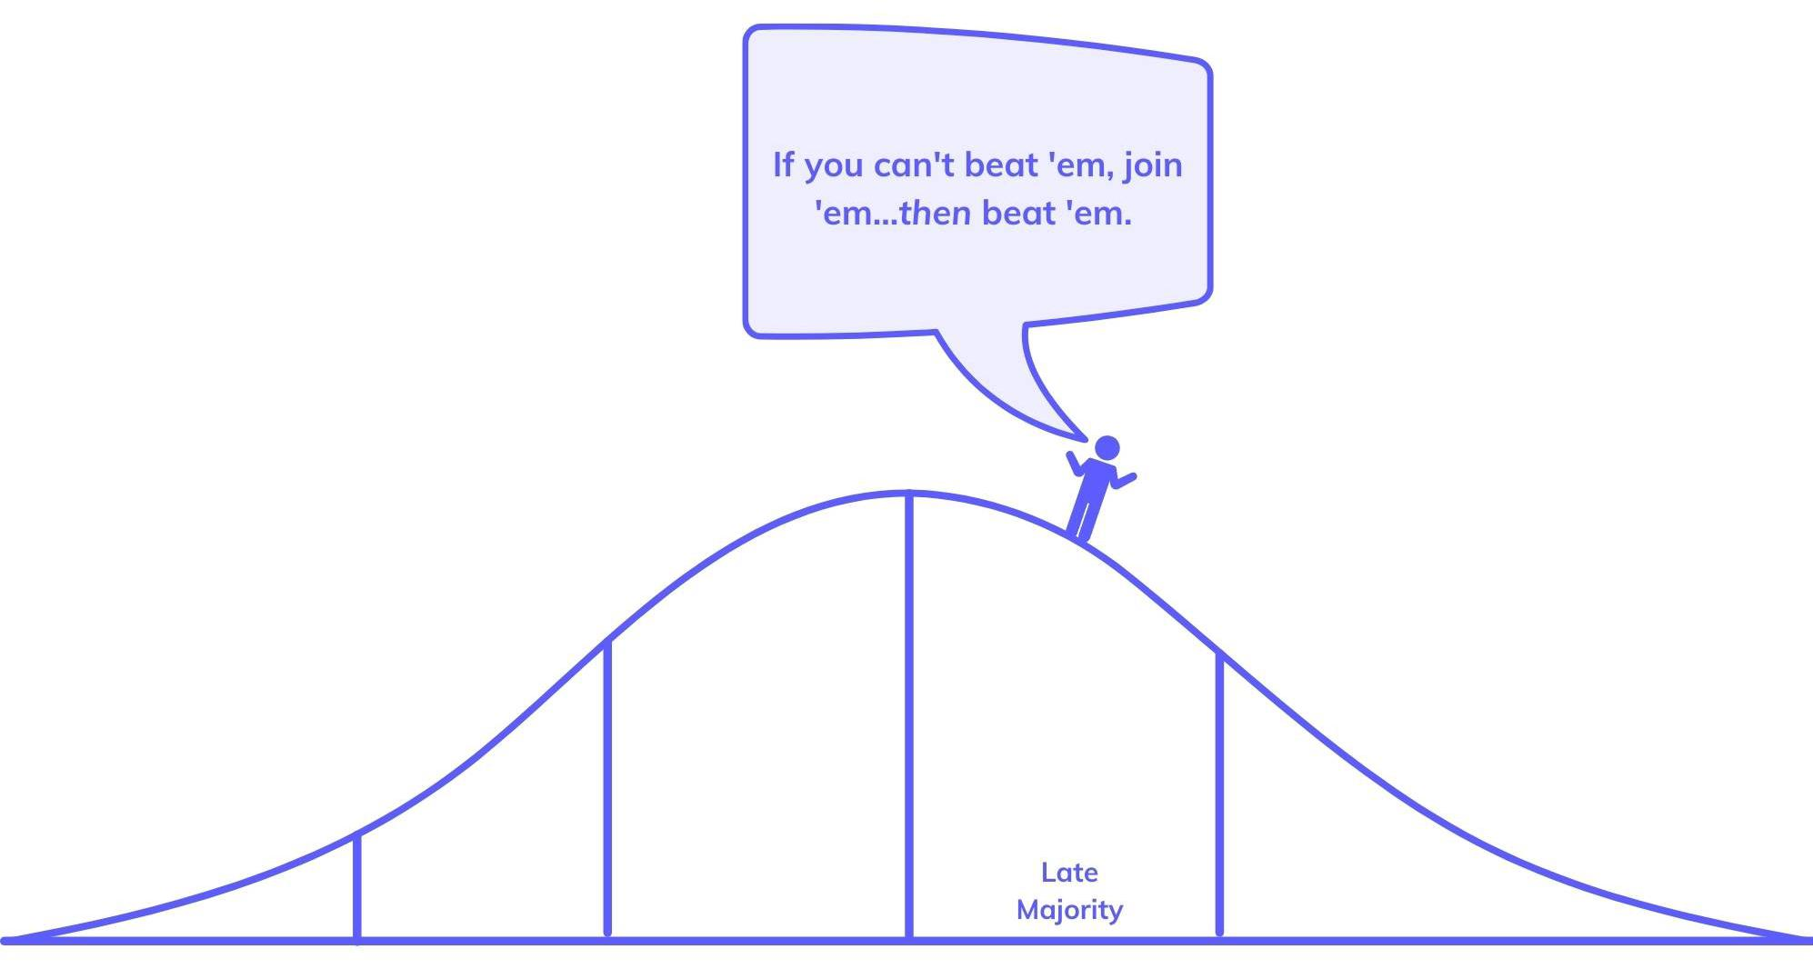
Late Majority
adopting new technology just after the average consumer

Slide 24
Late Majority factors
Are typically skeptical about an innovation – approach it after the majority of society has adopted the innovation
Usually have below-average social status
Very little financial lucidity
Discover new technologies through contact with the late majority and early majority, but not usually with innovators

Slide 25
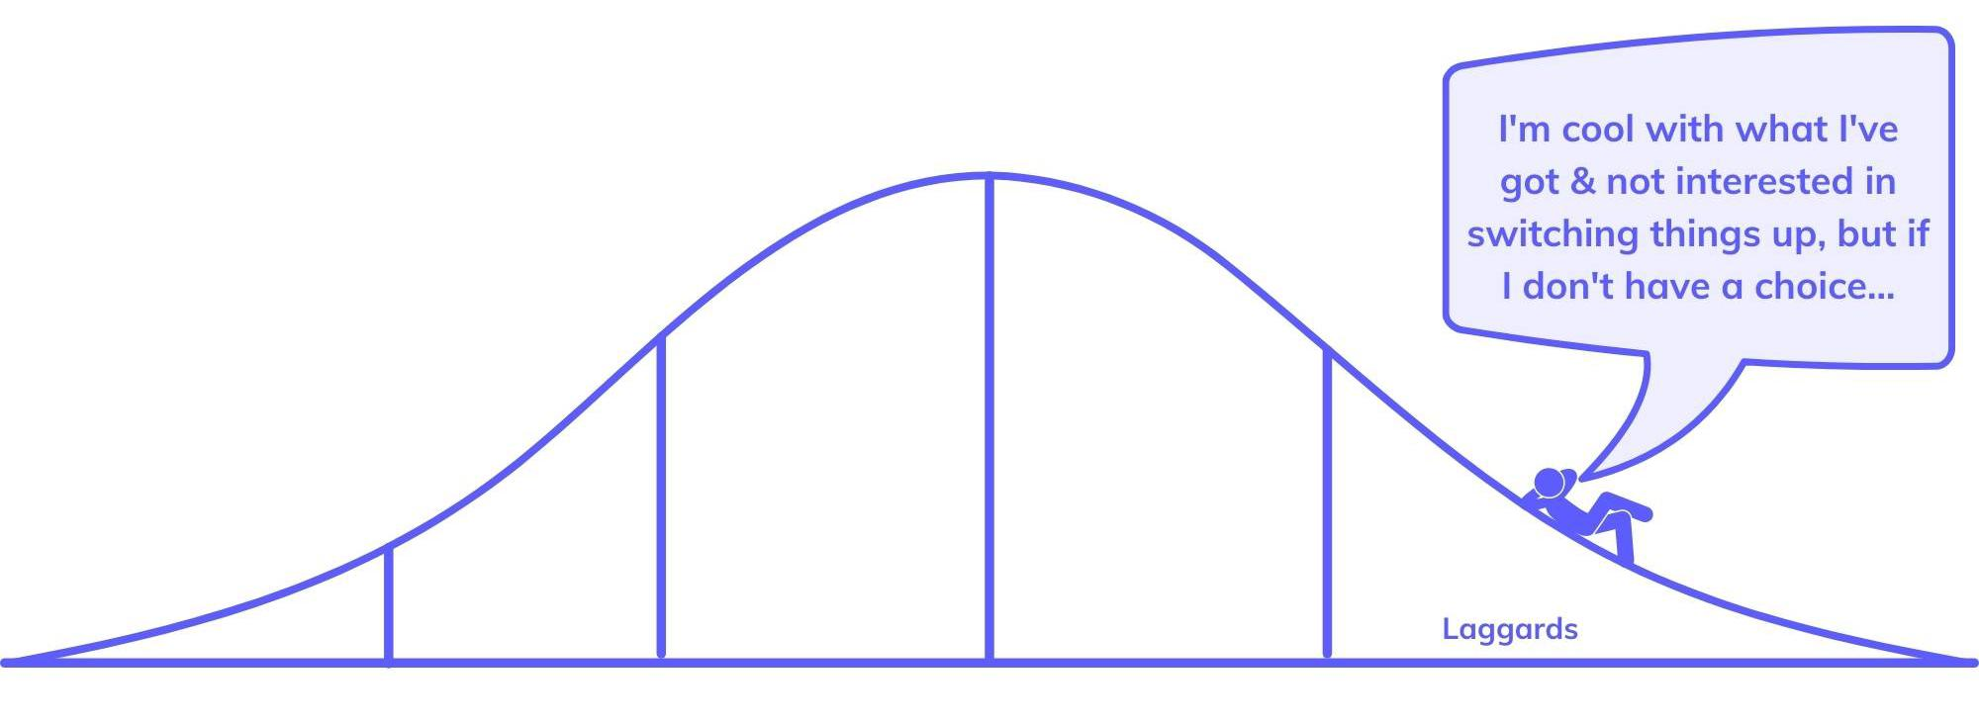
Laggards
Last to adopt an innovation

Slide 26
Laggards factors
Are likely to have the lowest social status and the lowest financial lucidity
Usually are in contact only with family and close friends
These individuals typically have an aversion to change-agents
Laggards typically tend to be focused on "traditions“
For example, a laggard may only use a cloud service when it is the only remaining method of performing a required task, but the laggard may not have an in-depth technical knowledge of how to use the service.

Slide 27
Five stages of the adoption process
Knowledge / Awareness
Persuasion
Decision
Implementation
Confirmation / Continuation
Different groups of adopters take different time to go through each stage

Slide 28
Knowledge / Awareness
The individual is first exposed to an innovation, but lacks information about the innovation
During this stage the individual has not yet been inspired to find out more information about the innovation

Slide 29
Persuasion
The individual is interested in the innovation and actively seeks related information/details

Slide 30
Decision
The individual takes the concept of the change and weighs the advantages/disadvantages of using the innovation and decides whether to adopt or reject the innovation

Slide 31
Implementation
The individual employs the innovation to a varying degree depending on the situation
During this stage the individual also determines the usefulness of the innovation and may search for further information about it

Slide 32
Confirmation / Continuation
The individual finalizes his/her decision to continue using the innovation

Slide 33
Technology adoption life cycle
Predicts that as a technology matures
the number of potential new buyers first increases (as the technology starts to catch on)
and then decreases (as technology providers run out of potential customers who haven’t already bought it)

Slide 34
Diffusion of innovations
With successive groups of consumers adopting the new technology (shown in blue), its market share (yellow) will eventually reach the saturation level
The blue curve is broken into sections of adopters

Slide 35
Technology driven models
These are particularly relevant to software diffusion
The rate of acceptance of technology is determined by factors such as ease of use and usefulness

Slide 36
Technology acceptance model
An information systems theory that models how users come to accept and use a technology
The model suggests that when users are presented with a new technology, a number of factors influence their decision about how and when they will use it:
Perceived usefulness
the degree to which a person believes that using a particular system would enhance their job performance
Perceived ease-of-use
the degree to which a person believes that using a particular system would be free from effort

Slide 37
Lazy user model
The lazy user model of solution selection (LUM) is a model in information systems that tries to explain how an individual selects a solution to fulfill a need from a set of possible solution alternatives.
LUM expects that a solution is selected from a set of available solutions based on the amount of effort the solutions require from the user – the user is supposed to select the solution that carries the least effort

Slide 38
Cloud adoption perspectives
Adoption
By society
We will talk about the research and theories in technology adoption area
By industries and businesses
We will look at practical issues faced by organizations
By countries
We will look at the results of recent surveys

Slide 39

Cloud adoption by industries and businesses
Technology adoption is the successful integration of new technology into the business
Adoption means more than just using technology
When the organization adopted new technology, it will use it to its fullest potential and see the benefits of using the new system

Slide 40
Industries that adopt cloud
A variety of industries benefit from cloud adoption
Healthcare
Marketing and Advertising
Retail
Finance
Education
…

Slide 41
Healthcare
Hospitals, clinics, and other medical organizations
Motivations for cloud computing adoption
Digital and social consumer behaviors
Need for secure and accessible electronic health records (EHRs)
Cloud computing applications
document storage
marketing
human resources

Slide 42
Marketing and Advertising
Motivations for cloud computing adoption – this industry is dependent on
social media
the quick creation and publishing of customer-relevant content
Cloud computing applications
agencies are using hybrid cloud adoption strategies to deliver critical client messages to their local and worldwide audiences

Slide 43
Retail
Motivations for cloud computing adoption
A successful e-commerce strategy requires a sound Internet strategy
With the help of cloud adoption Internet-based retail is able to effectively market to customers and save their product data for less money
Cloud computing applications
E-commerce

Slide 44
Finance
Motivations for cloud computing adoption
Need for efficient customer communications
Cloud computing applications
email
marketing tools

Slide 45
Companies of varying sizes adopt cloud
Large Companies and Corporations
Small and Mid-Size Companies
Entrepreneurs and Startups

Slide 46
Large Companies and Corporations
Motivations for cloud computing adoption
Corporate environments require the largest IT investment
Enterprise cloud adoption results in significant bottom line savings by
improving efficiency
eliminating the need for a large security and maintenance staff
lowering the cost of server space

Slide 47
Small and Mid-Size Companies
Motivations for cloud computing adoption
An increase in staff, clientele, and projects often require small and mid-size organizations to quickly grow their IT infrastructure
Engaging in cloud computing allows for efficient and cost-effective scalability that takes minutes instead of days

Slide 48
Entrepreneurs and Startups
Motivations for cloud computing adoption
Choosing the cloud instead of an expensive IT infrastructure reduces startup costs and up-front software investments
Software-as-a-service (SaaS) vendors now commonly offer a monthly fee subscription model

Slide 49
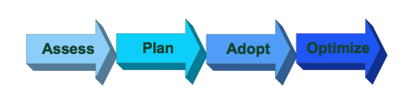
How does cloud adoption work?
In order to make the transition to the cloud, organizations must keep a few critical steps in mind

Slide 50
Assess
Executives and IT decision makers must assess the opportunities and challenges of employing a cloud computing strategy in their marketplace
In addition to researching popular vendors within their industry, business leaders and their technology teams should glean data on the challenges and successes of past adopters in their space

Slide 51
Assess - activities
Assessment activities
Assess the cloud deployment challenges
Evaluate and document the risks and barriers involved in cloud adoption
Assess the cloud deployment opportunities
Assess the cloud deployment success rates in the market
Evaluate and document the success stories
Assess the cloud vendors for cloud partnerships
Assessment goals
Understand the business value
Understand IT feasibility
Understand success factors for your organization to deploy your applications in cloud

Slide 52
Plan
Once organizations do their research, they must plan their specific cloud strategy
IT leaders should choose platforms and services that are well-known to their industry and quick to market
They should also decide between a public, private, or hybrid cloud

Slide 53
Adopt
During the adoption phase, IT leaders should develop risk mitigation strategies
They should also have an expert understanding of their servers, software, and data stores for the future reiteration and scalability of their strategy

Slide 54
Optimize
By meeting regularly with their executive team, IT departments can discuss lessons learned in their cloud computing strategy and create new and improved solutions for further processes and tasks

Slide 55
Challenges during cloud adoption
Security
Educating staff
Improving process
…

Slide 56
Security (1)
Use secure interfaces and APIs
Enterprises should take care to ensure software user interfaces (UIs) and application programming interfaces (APIs) are updated – and safe
Consistent management and monitoring of reputable tools will help protect against malicious and unforeseen breaches and errors

Slide 57
Security (2)
Prevent system vulnerabilities
Program bugs allow hackers to take control of cloud systems or steal data
Keeping track of system updates and quickly identifying vulnerabilities can help eliminate this risk

Slide 58
Security (3)
Create training programs and disaster plans
Natural disasters, accidental deletion, and insufficient due diligence in adopting cloud technologies can lead to data loss and malicious attacks
Companies of all sizes should create a cloud computing roadmap and employee training program to mitigate these issues

Slide 59
Educating Staff
Today’s enterprises include employees of various ages and technical skill levels
Along with security training, organizations should continue to educate teams in various departments about how to use the cloud and minimize daily operational challenges

Slide 60
Improving Processes
Companies must become adept at using various integrated services, especially in a hybrid cloud environment
IT should be prepared to move data to different service providers to adjust to demand and optimize processes

Slide 61
Cloud adoption perspectives
Adoption
By society
We will talk about the research and theories in technology adoption area
By industries and businesses
We will look at practical issues faced by organizations
By countries
We will look at the results of recent surveys

Slide 62
Cloud adoption in APAC - 2022
Forrester - a leading global research and advisory firm – surveyed decision-makers across all APAC countries on how they adopt cloud technology
APAC – Asia-Pacific (including India, China, Japan, Malaysia, Vietnam, Thailand, Australia and New Zealand)
Report results
China and India lead cloud adoption in the Asia Pacific (APAC) region, followed by Australia and New Zealand
92% of China-based respondents use cloud in some form
In India, 91% of decision-makers said that they use some form of cloud technology
In Australia, 87% of respondents said that they use cloud in some form
In New Zealand, overall cloud adoption is lower than Australia due to more restrictive regulations and fewer cloud data centers

Slide 63
Cloud adoption in China (1)
According to International Data Corporation (IDC), after more than ten years of development, China’s cloud infrastructure market is growing at the world’s highest rate
The overall market size of China’s public cloud services has reached US$19.38 billion, and the IDC predicts that the global share of China’s market will increase from 6.5% in 2020 to over 10.5% by 2024.

Slide 64
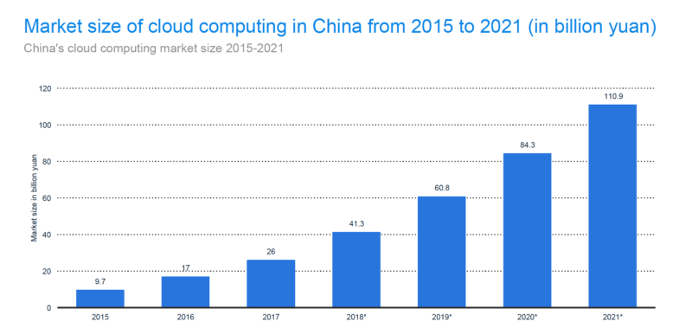
Cloud adoption in China (2)

Slide 65
Cloud adoption in China (3)
According to a Canalys (the leading global technology market analyst firm) report in 2020, Four Chinese companies are dominating China’s cloud infrastructure services market: Alibaba Cloud, Huawei Cloud, Tencent Cloud, and Baidu AI Cloud.
These companies collectively account for around 81% of the market share in China, while Alibaba Cloud stands out with a 45% share

